Slide 1
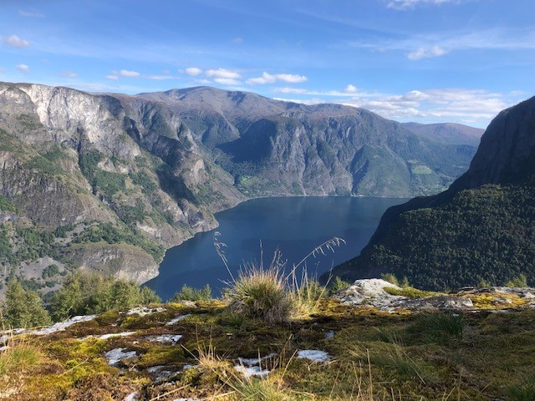
Relaxation and Mindfulness Practice after Brain Injury
UW Department of Rehabilitation medicine
Mary Curran, MSW, LICSW
July 2024

Slide 2
Learning Objectives
We will explore how the mind and body work together during pain
How relaxation can help
Some tips on developing a relaxation practice
Learn relaxation skills such as breathing, mindfulness meditation and guided imagery

Slide 3
Pain & TBI
Pain is common after TBI
Most common pain sites: headache, back, neck, arm, legs, and joints
Typically requires more than one strategy or treatment
Some people benefit from medication, most people need to include exercise and other approaches too
One strategy that is recommended to manage pain is learning how to relax

Slide 4
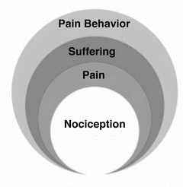
How the mind & body work together during pain
Adapted from Loeser’s model of pain
Notes:
.

Slide 5
The brain is in charge
Gate Openers:
Gate Closers:

Slide 6
Benefits of Relaxation
Decreased heart rate, respiration rate and blood pressure
Less muscle tension and pain
Decreased circulation of stress hormones
Appears to have an effect on the areas of the brain that are involved in pain perception and modulation
Fewer negative, stressful and anxious thoughts
Increased feeling of calm
Improved sleep

Slide 7
Tips for Practicing Relaxation Techniques
Relaxation exercises are skills that you can use to improve your health
Relaxation is a skill you can use anytime you feel stress or pain, are trying to sleep, or want to take a break and relax
Best to practice often
Try to find a quiet place to relax
Practicing in a calm and quiet place makes it easier to relax

Slide 8
Mindfulness
Definition: Paying attention to the present moment without judging it, without being swept away by it
On autopilot - not present for much of our lives
Mindfulness involves becoming more aware of our thoughts, body, and feelings, in each moment
Key ingredient-self-compassion & curiosity
Learn to respond not react
Gives us more freedom and choices

Slide 9
Relaxation Skills
Diaphragmatic breathing
Focuses on breathing to help you relax
One of the easiest and most effective relaxation skills
Diaphragm activated so that more air can be inhaled; allows you to breathe more deeply
Mindfulness Meditation
3 minute breathing space
Body Scan
Mindfulness of breath, body, thoughts
Progressive Muscle Relaxation
Helps you to learn to pay close attention to feelings of tension & relaxation in your body
Learn to tense and release various muscle groups throughout the body
Important to tense muscles first in order to ultimately produce relaxation
Guided Imagery
Allows you to take yourself out of your current situation & explore a relaxing situation in your mind, experiencing this setting fully with all your senses

Slide 10

Practice
Relaxation Breathing
Mindfulnss Meditation & Guided Imagery
Relaxation Breathing
Mindfulness Meditation & Guided Imagery

Slide 11
Summary of key relaxation messages
Practice regularly, even when you are not in pain/stressed
Can have beneficial effects, including reducing the number and severity of painful episodes, particularly headaches
The good news is that, unlike many medications, the more you use (relaxation), the more benefit from it you’ll discover
Tips: practicing in quiet, calm place makes it easier to relax
Learning to relax takes time, so be gentle with yourself

Slide 12
Relaxation & Mindfulness Resources
There are many relaxation & mindfulness resources to support your practice including:
  Online (websites):
    Mindfulness Northwest
    Love Your Brain
    Greater Good Science Center at UC Berkeley
  Audio-recordings:
    My MS Toolkit- relaxation recordings
    UCLA Mindful Awareness Research Center-guided meditations
  Smart-phone apps:
    Healthy Minds Program, Insight Timer, Calm, Headspace, Smiling Mind

