Slide 1
Finding Time, Ways, and Motivation to Move More
Charles H. Bombardier, PhD
Professor, Department of Rehabilitation Medicine
University of Washington

Slide 2
Acknowledgement
Brought to you by the Brain Injury Association of Washington
With support from the University of Washington Traumatic Brain Injury Model System grant funded by the National Institute on Disability, Independent Living and Rehabilitation Research
The presentation includes information from the U.S. Department of Health and Human Services. Physical Activity Guidelines for Americans, 2nd edition. Washington, DC: U.S. Department of Health and Human Services; 2018.

Slide 3
Before we start
I have had a bunch of advantages in life that I did not earn such as being male, White, straight, middle class background
I have no history of TBI
As a result, I have biases and areas of ignorance and inexperience
I will get things wrong, display racist, ableist biases at times
I strive to be open to feedback and criticism to foster learning in all
Also, I will be going over a lot of material, too much to take notes on everything. If what I talk about today is useful to you and you would like a copy of my slides just email me at chb@uw.edu

Slide 4
Physical activity is any bodily movement produced by contraction of skeletal muscles that results in a substantial increase in energy expenditure over resting levels
Physical Activity
Exercise
Exercise is a subset of physical activity that is planned, structured, and repetitive with the objective of improving or maintaining physical fitness
Caspersen et al Public Health Reports 1985

Slide 5
Physical Activity Categories
Leisure time physical activity
Physical activity that is not part of normal daily life such as sports, exercise, recreational activities
Lifestyle physical activity
Physical activity that is part of daily life related to household, work, and school responsibilities as well as transportation
Sedentary Behavior
Activities that use minimal energy such as sitting at a desk, driving a car, watching TV; and sitting without moving for wheelchair users

Slide 6
Types of Physical Activity: Aerobic
Definition:
Activity in which the body’s large muscles move in a rhythmic manner for a sustained period of time.
Examples:
Brisk walking
Running/jogging
Swimming
Bicycling

Slide 7
Three Components of Aerobic Activity
Intensity, or how hard a person works
Frequency, or how often a person does the activity;
Duration, or how long a person does an activity in any one session.

Slide 8
Types of Physical Activity: Strength Training
Definition:
Physical activity, including exercise, that increases muscle strength, power, endurance, and mass.
Examples:
Lifting weights
Using resistance bands
Bodyweight exercises
Carrying heavy loads
Heavy gardening

Slide 9
Three Components of Muscle-Strengthening
Intensity, or how much weight or force is used;
Frequency, or how often a person does the activity; and
Sets and repetitions, or how many times a person does the activity

Slide 10
Types of Physical Activity: Mind-Body
Definition:
A form of exercise that combines body movement, mental focus, and controlled breathing to improve strength, balance, flexibility, and overall health.
Examples:
Yoga
Tai Chi
Qi gong
Pilates

Slide 11
Physical Activity Guidelines for Adults
People get additional health benefits if they:
Move more and sit less
Get at least 150 minutes per week of moderate aerobic activity or at least 75 minutes of vigorous aerobic physical activity
Do at least moderately intense muscle strengthening activities 2 or more days per week; involving all major muscle groups
For people with chronic conditions and older adults, be as physically active as your condition and abilities allow

Slide 12
Estimating Workout Intensity
Moderate Intensity
5 or 6 on a scale of 0 to 10
Vigorous Intensity
7 or 8 on a scale of 0 to 10
You can talk but cannot sing
You cannot say more than a few words without pausing for a breath

Slide 13
Estimate Your Physical Activity Level
On average how many days per week do you engage in moderate to vigorous physical activity (like a brisk walk)? _________ days
On average, how many minutes do you engage in physical activity at this level? ______ minutes
Total minutes per week of physical activity (multiple days times minutes _____ minutes per week
https://www.exerciseismedicine.org/

Slide 14
Is Physical Activity Safe?
To be safe and reduce risk of injuries or health problems, people should:
Understand the risks, yet know that physical activity can be safe for almost everyone.
Choose types of physical activity that are appropriate and safe for you.
Increase physical activity gradually over time. Inactive people should “start low and go slow.”
Use appropriate gear and sports equipment, choose safe environments, follow rules and policies, and making sensible choices.
People with chronic conditions and symptoms can consult a health care professional or physical activity specialist about the types and amounts of activity appropriate for them.

Slide 15
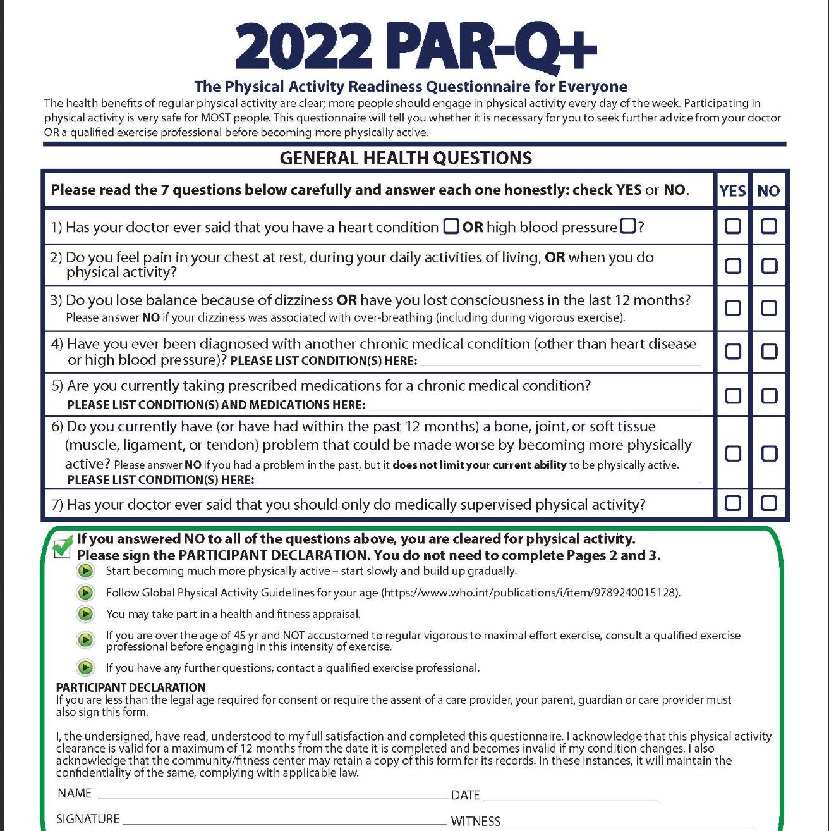
Is is Safe For You to Exercise?
https://eparmedx.com/

Slide 17
Motivation = Importance x Confidence
10
Motivation
Importance
0
0
Confidence
10

Slide 18
Enhancing Importance

Slide 19
Importance: Start with why
Why might you WANT to be more physically active?
Could be positive--benefits of more physical activity
Could be negative-harms of remaining less physically active
Often linked to core values that motivate us

Slide 20
Hearing from you…
Why do you try to be more active in your daily life?
What are some of the benefits that you have gotten from physical activity?

Slide 21
Longer-Term Benefits of Physical Activity
Lower risk of death
Lower risk of heart disease
Lower risk of diabetes
Lower blood pressure
Lower risk of dementia
Weight loss
More energy/Less fatigue
Improved cognition
Improved mood
Lower anxiety
Better sleep
Less pain
Better quality of life

Slide 22
Immediate/Short-term Benefits of Exercise
A single bout of moderately intense exercise decreases negative affect:
depression, stress, anger, confusion
And increases positive affect e.g., feeling energized
Basso & Suzuki, Brain Plasticity 2016/2017 127-152; Wender et al., PM&R 2023
Weir, APA Monitor, December 2011, Vol 42, No. 11, p. 48 ff.

Slide 23
Immediate/Short-term Benefits of Exercise
Exercising for as little as 5 minutes improves mood.
Improved mood lasts up to 24 hours
Starting out exercising too hard can prevent you from getting the psychological benefits
Being able to engage in preferred physical activities boost effects
Basso & Suzuki, Brain Plasticity 2016/2017 127-152; Wender et al., PM&R 2023
Weir, APA Monitor, December 2011, Vol 42, No. 11, p. 48 ff.

Slide 24
Exercise is a promising treatment for depression
Meta-analysis of 25 studies shows exercise significantly reduces depression
The three main exercise types all have a similar effect on depression severity
Aerobic exercise
Mind-body exercise
Resistance exercise (strength training)
Schuch et al., J Psychiat Res 2016; Miller et al., Ageing Res Rev 2020

Slide 25
Effects of Exercise in Neurological Conditions
Exercise was superior to treatment as usual in improving:
Quality of life
Depressive symptoms
Cognition including attention, working memory, executive functioning, memory, psychomotor speed
More minutes per week of exercise was associated with a larger anti-depressant effect
Exercise was safe, most studies found no complications
Meta analysis of 122 studies none in TBI; Dauwan et al J Neurology 2021

Slide 26
Effects of Exercise in TBI
A graduated walking program significantly reduced fatigue
Randomized crossover study of graded walking program vs. nutrition class showed walkers had improved depression and stress compared to nutrition class
Review of five small studies of Tai Chi/Quigong in people with TBI suggest Tai Chi can improve functioning, thinking abilities, and psychological status, caregivers and clinicians showed that participation was related to improved quality of life, resilience, emotional/behavioral regulation, cognition, positive affect, and well-being.
(Kolakowski-Hayner et al., Neurol Rehab 2017; Bellon et al., Brain Inj 2014; Lasowsky et al., BMC Complement Med and Therapies 2022; Callahan et al Brain Inj 2023

Slide 27
What benefits stand out to you?
I presented a lot of additional information about the potential benefits of exercise.
Were there any new benefits were relevant to you or stood out as being important?

Slide 28
Importance: Link to core values
Personal example
What are some of the reasons you want to exercise more?
I want to be more healthy.
I consider myself an athlete and want to remain that way.
I want to have more endurance so I can hike with my wife.
I have had some health problems and exercise might help.
I love my wife. She is so worried about my health. If I exercise I might improve my chances of recovery and reassure her that I am doing everything I can to survive.

Slide 29
Which Core Values Do You Relate To Exercise?
Good parent
Good spouse/partner
Competent
Healthy
Attractive
Energetic
Responsible
Youthful
Athletic
Spiritual
Considerate
Disciplined
Respected at work
Efficient
Independent
Good role model
In control
Strong
Popular
Faithful
Other ___________

Slide 30
Enhancing Confidence

Slide 31
Building Confidence To Be More Active
Baby steps: Start low go slow
SMART goal setting
Commit
Self-monitor progress
Reward yourself
Notice and use prompts and cues
Problem solve barriers

Slide 32
Baby Steps: Start low, go slow
We often set our goals too high, then fail, get frustrated, and give up
This erodes our confidence and makes exercise unpleasant
Instead, set goals that will increase your confidence and enjoyment
Set a goal, then ask yourself how confident you are that you can achieve it. If your confidence is less than 80%, revise your goal
Think about a physical activity that you are already doing and just build on it e.g., when you walk out to the curb to get your mail, walk a bit further; when you walk up the stairs in your home, do it twice
Choose activities that you enjoy now or used to enjoy: dancing, sports, swimming, hiking, walking, gardening--just move more

Slide 33
SMART Goal Setting
 |  | TIPS | YOUR GOAL
S | SPECIFIC | What type of exercise will you do? Where?
M | MEASUREABLE | How long? How intense? How often?
A | ATTAINABLE | On a scale from 0-10 how confident are you that you will do it? What could help increase confidence?
R | RELEVANT | How important is it for you to meet this goal? What value does it relate to?
T | TIME-BASED | When (day/time) will you plan to do it. what is your deadline?

Slide 34
SMART Goal Example
Go for brisk 15-minute walk, 4 days/week, after work/5 pm, for 2 weeks.
Why this a good example of a SMART goal:
Specific: The type of exercise (walking) is well-defined.
Measurable: You can easily keep track of whether the goal is being met (four times per week, at least 15 minutes, every week).
Attainable/Realistic: The goal is realistic. You can do it. What is realistic is different for each person based on current activity level, taking gradual steps to increase activity is key.
Relevant: Connected to long term goal of being able to have more energy to play with children. It is important to what you value.
Time-Based: The goal has an achievement end date (2 weeks).

Slide 35
Commit
I promise to go for brisk 15-minute walk on Monday, Tuesday, Wednesday, and Thursday after work at 5:00 PM for the next two weeks.
_____________________________ 5/9/2024
Signature Date

Slide 36
Self-Monitoring Strategies
Writing it down:
A small notebook just for this purpose
Schedule bouts of physical activity on calendar or planner you already use
Checking it off:
Have a box to check for every bout of physical activity that you complete
You can also record what activity you did, how long or how far you went, etc.
Using technology:
Use physical activity monitoring app on smartphone, watch, or step counter
Use a computer spreadsheet to record data

Slide 37
Reward yourself
Put gold stars or colorful stickers on a calendar to mark which days you exercised.
Put money in a jar every time you work out. Use the money to treat yourself to something special.
Reward yourself after you exercise with rest, a cold drink, healthy snack, a nice shower, hot bath, etc.
Proudly share accomplishments with supportive friends or family

Slide 38
Notice and use prompts and cues
Cues are things in our environment that make us want to do something.
Cue: You see a jar of cookies on the kitchen counter.
Action: You eat cookies.
Cue: The TV is on.
Action: You sit or lie down to watch it.
What cues in your daily life cause you to be less active?
What cues in your daily life cause you to be more active?
Get rid of one cue that causes you to be less active.
Add one positive cue for being more active

Slide 39
Behavior Prompt | Cue
Go for a walk to break up the workday | Program reminders into phone
Go for a swim after work | Place goggles beside computer
Exercise first thing in the morning | Set gym clothes beside bed
Go for a walk after getting dressed in AM | Put a sticky note on the bathroom mirror
Ensure you get daily exercise | Have someone text you to ask if you’ve exercised before the end of the day
Decrease long periods of time working at a desk without moving | Set timers on your phone or computer to remind you to move every hour or so
Meet the guidelines for exercise | Circle days you want to exercise on desk calendar
Go for a workout after lunch | Pack gym clothes under lunch bag
Go for a bike ride after reading | Put a sticky note reminder on a page a couple of chapters ahead

Slide 40
Problem solving barriers to exercise
Common Barriers to Activity
Check the barriers that apply to you: Time limits (work, family, etc.) Forgot/didn’t remember Mood/didn’t feel like it Pain flare up/injury Disability keeps me from exercising Couldn’t find a place to exercise | Lack of transportation Lack of accessible facility Cost of program/financial Didn’t have right equipment Don’t have enough endurance Feel self-conscious exercising Other?

Slide 41
Identifying barriers and solutions
Of the barriers that you checked off, which 1 or 2 are most likely to get in the way of you being physically active?
What are some things you can do to cope with these barriers?
Barrier | Coping strategies/solutions
1. | 1.
2. | 2.
3. | 3.

Slide 42
Time as a barrier and coping strategies
One of the most common problems is lack of time. Everyone's busy these days and you can find the time to be active. Here are two different ways to cope with lack of time.
Plan it: Set aside a block of time to exercise every day. Make it part of your daily routine, like taking a shower. Think about your typical day. When could you take 20-30 minutes to do a physical activity that you like?
Be spontaneous: Be on the lookout during the day for 10-15 minutes of free time to be active. What are some good ways to fit in exercise? What are some good short workouts?

Slide 43
Problem solve: Turn Inactivity into Activity
Get off the bus before your stop and walk the rest of the way.
Walk up stairs rather than use the elevator
Walk to a nearby store rather than driving.
Do yard work rather than hiring someone else to do it.
Use a rake rather than a leaf blower.
Go for a 2-minute walk during TV commercials
Ride stationary bike or lift weights while watching TV.
Stand up while you're on the phone instead of sitting.
Have walking meetings rather than sitting meetings

Slide 44
Problem Solve: Fitness Snacking
Not every workout needs to be 30 minutes. Fitness snacks are short bouts of 5-10 minutes of movement throughout the day, as opposed to one long workout session. Learn about from site below.
https://rightasrain.uwmedicine.org/exercise/how-much-exercise-do-you-really-need
Exercise scientists have designed full-body workouts that can be done in just 7 minutes with no equipment. See a classic one below. Look for free 7-minute workouts in the app store if you have a smartphone. The apps show you how to do each exercise properly and lead you through the workout.
https://www.youtube.com/watch?v=2sezktSxLt8

Slide 45
Resources
Love Your Brain
https://www.loveyourbrain.com
Physical Activity Recommendations for Adults with Chronic Health Conditions and Disabilities:
https://www.cdc.gov/physicalactivity/basics/pdfs/PA-adults-with-chronic-health-conditions-508.pdf
What’s your move?
https://health.gov/sites/default/files/2019-11/PAG_MYW_Adult_FS.pdf
National Center for Health and Physical Activity in Disability
https://www.nchpad.org/

Slide 46
Summary
Physical activity is a powerful tool for people to improve their health in many different areas from sleep to depression to cognition
No matter where a person is now, they can make small changes in physical activity to improve their health
Both sitting less and being more active seem to make a difference
There are a number of tools we can use to increase motivation to be more active by enhancing the importance and building confidence
If you want to, you can decide to take a small step towards becoming more physically active now

Slide 47
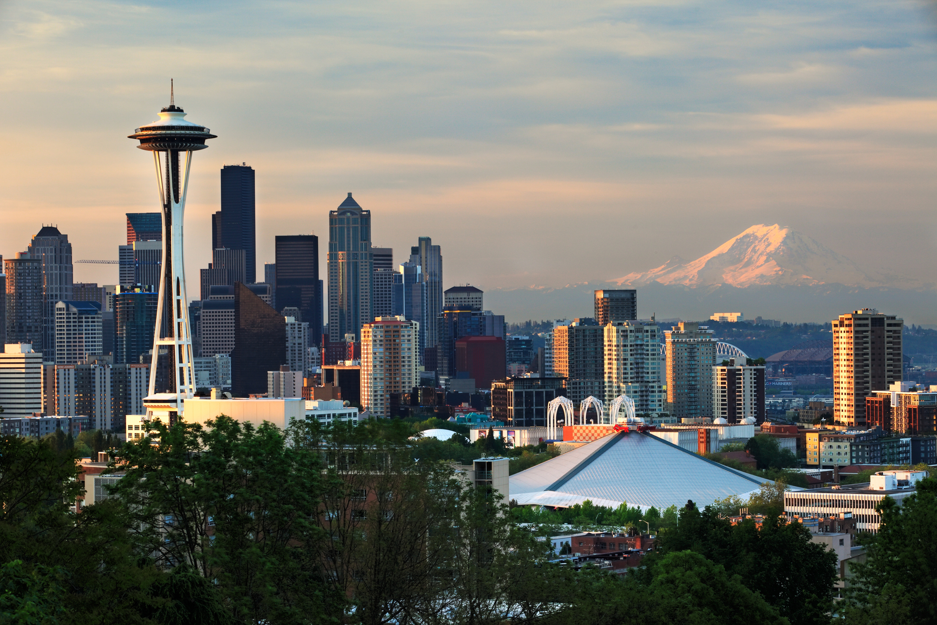
THANK YOU
chb@uw.edu

