Slide 1
Statistics for Research: The Why and How
Andrew Humbert
June 20, 2024

Slide 2
Motivation
Can a new app increase the amount of physical activity following a traumatic brain injury?
We know the app probably won’t help everyone
But will it provide an average benefit?
We could conduct a randomized clinical trial
How will statistics be used to make conclusions about the study?

Slide 3
Treatment

Slide 4
Treatment
Statistics

Slide 5
Statistics in four measures
Point estimate
Variability
Confidence interval
P-value

Slide 6
Point Estimate
The single best guess based off our sample
Often the average or proportion
May be the difference between two groups
Example: Those given the app had 15 minutes more physical activity per week
However, a different sample may have a different estimate!
A different sample may have only had a 10-minute difference
Another may have had a 17-minute difference

Slide 7
Point Estimates from multiple samples

Slide 8
Variability
We know the estimates from different samples will vary
Can we quantify this?
Standard error
The more variable individuals are, the higher the standard error
The larger our sample size, the smaller the standard error

Slide 9
Confidence Intervals
Give us a range in which we are confident the true value lies
Usually, 95% confidence is chosen
95% of all intervals created this way will contain the true value
5% won’t
We never know if we are in the 95% or 5%
Example: If our 95% confidence interval is 10-20
We are 95% confident that the true impact of the app is 10-20 minutes

Slide 10
Point Estimates with Confidence Intervals

Slide 11
P-value
We often want to know how unlikely our results are due to chance
Recall: A treatment may look effective in a sample by chance even if it isn’t!
We first need to imagine a scenario where there is no treatment effect
I know the treatment doesn’t work
We then see how frequently our results (or more extreme) would occur until this scenario
We can calculate this theoretically or through simulations
This is the p-value!
Usually anything less than 5% is considered statistically significant

Slide 12
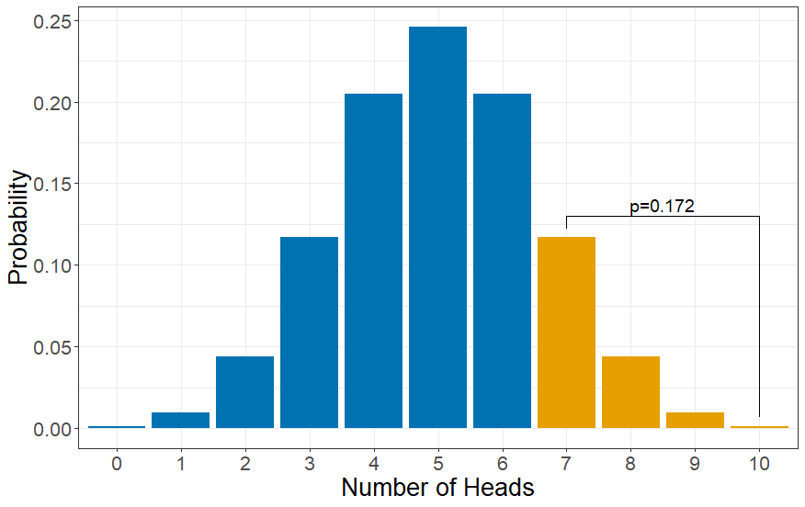
Probability of 7 or more heads

Slide 13
Summary
Statistics helps us use a sample to make conclusions about a population
Point estimates: Single best guess
Variability: How much our point estimate differs if we could resample
Confidence intervals: Range that we are confident contains the true value
P-values: How likely our results are to occur by chance if no effect is present

