Slide 1
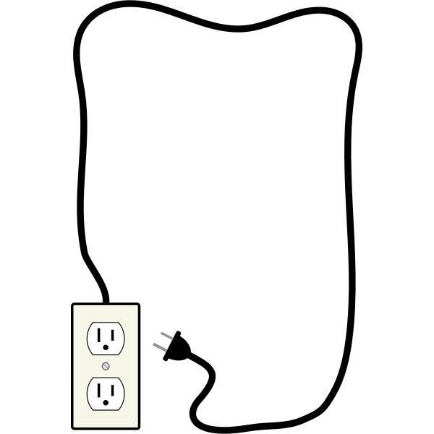
ABCs of Problem Solving and Reconnecting to Your Goals after Brain Injury – Part 2

Slide 2
PRESENTERS
Sara Fey-Hinckley, LMFT, CBIS
Erin Rants, MSW
Both Sara and Erin are TBI Care Managers/Research Interventionists on the BRITE Study in the Department of Rehabilitation Medicine at the University of Washington.

Slide 3
A Little Housekeeping
Please hold questions until the points when we’ll ask for questions.
You can write questions in the ‘chat’ at any time, and we’ll answer them at the stopping points.
When we break for questions, please speak up with your questions or have already put them in the ‘chat'.

Slide 4
A Little (more) Housekeeping
Please find the worksheet from Jenna’s email OR have a pen and piece of paper handy.
Notes:
For the goal-setting exercise that we’ll start a little later, you will have received an email from Jenna with an attached worksheet that you can use for the goal-setting exercise, if you want. If you have a printer, you can print it out. Or grab a pen and a piece of paper - when we get to the exercise, it’s fine to just write your answers on plain paper.

Slide 5
QUESTIONS

Slide 6
GOALS and IDENTITY
In our last class, we learned that:
Every action you take is like a vote
for the type of person you want
to become.
Behaviors help you embody a
particular identity.
Notes:
Motivation is not the key – if you have a desire to create a goal, you have some inherent motivation.
Let your behavior drive your beliefs.

Slide 7
GOAL SETTING &
PLAN IMPLEMENTATION:
4 Principles for your Consideration

Slide 8
PRINCIPLE #1: You Want Your Goal to be OBVIOUS
Chosen goals should be obvious, available, visible, easy to see.
There is a benefit to asking yourself, “What kind of results do I want?” because the answer can be concrete.

Slide 9
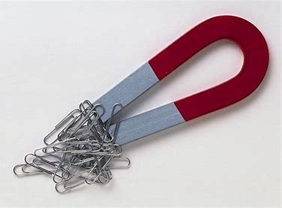
PRINCIPLE #2: You Want Your Goal to be ATTRACTIVE
The more attractive or appealing a goal is, the more you are going to feel motivated to do it.
A commitment device is a choice that you make in the present that locks in, or commits you, to a behavior in the future.

Slide 10
PRINCIPLE #3: You Want Your Goal to be EASY
Make it small.
Try the ‘Two-minute Rule’.
Use your strategies to remind you (e.g., timers, notes).
Notes:
A habit has to be established before you can improve on it. For example someone might want to accomplish a really big goal like climbing a mountain. I know someone with a severe TBI who did this several years after his injury. He one day said, “I want to climb Mount Rainier.” He made that goal, and then he started SMALL - he made a plan for working out until he was ready to climb the first hill of the easiest mountain. He kept working out so he could continue to climb higher next time. He was flexible, and kept adjusting his plan when obstacles got in the way. And now, he’s climbed a number of smaller mountains, and is much further along with his plan to climb Mount Rainier to the very top.
Small, planned steps combine to take us to where we want to be. For many people, if they’re going to be successful, they aren’t going to start with really big goals like Mount Rainier. They’re going to want to do things like starting to take a daily walk, or starting to do the dishes every evening, or beginning to get out with friends. And they may decide to make bigger goals as they achieve the smaller ones.
A good way to start is by something called the “Two-minute Rule.” With this rule, you’re telling yourself that you only have to do the thing you’re wanting to get better at, but having trouble starting, for two minutes. Two minutes of dishes, then you can stop. Two minutes of walking. You’re making the steps so small that they’re doable, they’re easy to start.
Other strategies that can make taking the steps routine are to remind yourself with timers; lay out the things in advance that you’ll need to start the step (for instance, setting your shoes by the door when you’re planning to walk in the morning); or putting a note in a place you’ll notice it.

Slide 11
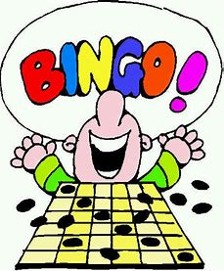
PRINCIPLE #4: You Want Your Goal to be SATISFYING
*Pro tip: It may not be satisfying until you’ve done it for awhile.
Notes:
The more satisfying or even enjoyable a habit is, the more likely you are to stick with it in the long run. But we need to do things in our lives that are not satisfying or enjoyable, right? For me, that would be doing dishes. So it’s a good thing that actions that we don’t think of with anticipation in the beginning can become satisfying and enjoyable over time. This often happens because, as Sara mentioned, you are making a choice to take an action that is helping you become the person you want to be. It’s an affirmation of your desired identity. And this affirmation reinforces the positive action you’re taking, and can make other less healthy actions feel at conflict with your desired identity. For example, if you want to be a person who walks for an hour at 8 am every morning, and you’ve been doing that for a week, it may start to feel at odds with your new habit to continue your old habit of staying up until 2 am on the Internet.
Goals are likely to be more satisfying if you’re the one setting them for yourself. And with goals that you set for yourself rather than someone else setting them for you, research has found that commitment to achieving them is often stronger. (Hart, 2006)

Slide 12
MAKE YOUR GOALS OBVIOUS
Identify the OUTCOME you would like to achieve by noticing something you would like to be different, something that is important to you, or something you would like to be doing that you are not currently doing:
CLEAN MY KITCHEN
EVERY DAY

Slide 13
IMPLEMENTATION INTENTION
I will DO MY DISHES
[BEHAVIOR] / [Use Your Outcome from Above to Guide You]
At by 8:00 pm
[WHEN]
In In My Kitchen
[WHERE]

Slide 14
MAKE YOUR GOALS ATTRACTIVE
Write your implementation intention here:
I WILL DO MY DISHES BY 8:00 PM IN MY KITCHEN.
Add to your implementation an action you will take that will increase the chances of following through. (It could be to ask a person/people to support you; set a timer to remind yourself; prepare ahead something you will need to follow through):
I WILL PUT AN ALARM REMINDER IN MY PHONE.

Slide 15
MAKE YOUR PLAN
Identify your first step toward following through on your plan:
PUT THE ALARM REMINDER IN MY PHONE.
If you want to include more steps, feel free to use the space below – steps can be as big or small (broken down) as you want:

Slide 16
In General, What Are Some Barriers People Might Encounter When Attempting to Implement a Goal?
Example: Time
Notes:
Try to solicit responses from most class participants.

Slide 17
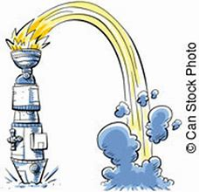
A Few Common Barriers:
Failing to Get Started
You might forget to get started.
TBI might be causing problems with initiation, planning, and memory.
The steps you plan to take to reach your goal aren’t a habit for you, so it’s hard to remember them and make them a priority.

Slide 18
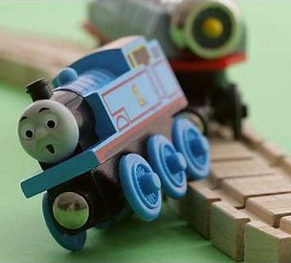
A Few Common Barriers:
Getting Off Track
After starting to work toward your goal, and maybe even making some progress, your attention is taken away from your goal. Distractions happen.
For example, maybe you got hooked into social media and spent several hours on it, it got too late, and too dark outside, and you didn’t go on the walk you planned.

Slide 19
A Few Common Barriers:
Not Changing Your Plan When
it’s Not Working
Sometimes this is called “throwing good money after bad.” You are taking the steps toward your goal, but you are not making progress. All the time and energy you are putting in, isn’t resulting in moving you forward.
For instance, you’re writing a report, while playing music and frequently checking your social media. You’re distracted, and your report A. May not get done; or B. May be done, poorly.

Slide 20
A Few Common Barriers:
Taking on Too Much
This means overextending yourself, doing too much so you no longer have gas in your tank to work on the steps to your goal.
For example, your goal is to finish a two-week online course for job-related skills. You’ve done a couple hours of yardwork with a neighbor, cleaned the bathroom, and walked the dog. The end of the day comes, and the last thing you want to do is to put in time on that online course.

Slide 21
What Were Some of the Specific Things That Stopped You (Or Have Stopped You in the Past) While Attempting Your Goal?
Notes:
Encourage them to use the handout – top of the page will include prompt/space to write down any challenges, barriers, difficulties, they encountered while attempting the goal.

Slide 22
When It’s Time to Evaluate Your Goal and Make Some ‘Tweaks’: A Few Suggestions
Celebrate each tiny success.
Don’t criticize or punish yourself for setbacks.
Goal-setting after brain injury requires time and practice – often through trial and error.
Be patient with yourself and do what you can.

Slide 23
When It’s Time to Evaluate Your Goal and Make Some ‘Tweaks’: A Few Suggestions
Be flexible with changes to your plans – if something’s not working for you, try again, and then try something different.
You may need to take a break and revisit your goals at a later time, and….
You may need to break certain goal-steps into smaller components, and….
You may need to ask someone for help with your goals.

Slide 24
When It’s Time to Evaluate Your Goal and Make Some ‘Tweaks’: If/Then Statement
The If/Then Technique is a good way to plan for chaos AND stick to your goals even when life gets crazy.
It encourages you to consider the unpredictable circumstances that enter our daily lives.
It reduces our excuses for doing nothing and increases options for sticking to your goals.
On any given day, it is more important to stick to the ‘spirit’ of your plan than to do it perfectly.
For example: If I don’t wake up to run tomorrow morning, then I’ll walk on my lunch break. OR,
If I buy something ‘not so healthy’ for breakfast, then I’ll cook a healthier meal for dinner and/or prepare breakfast ahead of time for tomorrow.

Slide 25
IF/THEN STATEMENT CONTINUED
All you need to do is complete this phrase:
“If [SOMETHING UNEXPECTED], then [YOUR RESPONSE].”
Another way to think about it is:
“When situation X arises, I will perform response Y.”
EXAMPLES:
“If I haven’t called my mom back by 7 pm, then I won’t turn on the TV until I do.”
“If my doctor doesn’t ask me about my pain levels, then I will send her a follow-up message via email.”
“If my friend cannot take me to the store tonight, I will ask him to take me tomorrow.”

Slide 26
CLASS EXAMPLES: (We love it when people share!)
Notes:
‘Crowd source’ some solutions to participant’s specific challenges or barriers: maybe two people?
Help two participants use solutions to write their If/Then statements (examples).

Slide 27
QUESTIONS

Slide 28
Let’s Get Started!
If you’d like to try the exercise, please get the worksheet
OR
a plain piece of paper
AND
a pen or pencil ready
Notes:
If you’d like to try the exercise, please get the worksheet
OR
a plain piece of paper
AND
a pen or pencil ready

Slide 29
IF/THEN STATEMENTS
Identify some of the solutions that you can brainstorm that might help you overcome the potential chaos, consider the unpredictable, reduce excuses, and increase options in order to move you closer to your goals?
Practice using the following formula to create a plan for how to move toward your goal: ‘If/When situation X arises, Then I will perform response Y’. [Refer back to your implementation intention.]
IF/WHEN _____________________________ (something unexpected)
THEN I WILL _______________________________ (your response).
Notes:
Middle of the page – prompt and space to write down their own possible solutions (brainstorming).
Bottom of the page – prompt and space to practice IF/THEN statements.

Slide 30
REFERENCES
Alison. (2016, March).‘Women and Brain Injury: What you need to know’. Toronto Brain Injury Blog. Brain Injury Society of Toronto (BIST). https://torontobraininjuryblog.wordpress.com/2016/03/31/mind-yourself-with-alison/
Clear, James. (2018). Atomic Habits. Manhattan, NY: Penguin Publishing Group.
Hart, Tessa PhD; Evans, Jonathan PhD. Self-regulation and Goal Theories in Brain Injury Rehabilitation, Journal of Head Trauma Rehabilitation: March-April 2006 - Volume 21 - Issue 2 - p 142-155
Plant, Sarah E., Sarah F. Tyson, Susan Kirk, and John Parsons. (2016). What are the barriers and facilitators to goal-setting during rehabilitation for stroke and other acquired brain injuries. A systematic review and meta-synthesis. Clinical Rehabilitation, 30 (9): 921-930.
Salzberger, Nils. (2016, April). ‘Implementation Intentions – The Simplest Way for Achieving Your Goals’. Njlifehacks Blog. https://www.njlifehacks.com/implementation-intentions/

